Slide 1
Rationale
Java is an object-oriented language that enables you to create real world applications. The code reusability feature of Java enables the developers to upgrade the existing applications without rewriting the entire code of the application.
Packages enable the reusability of classes and methods across various applications.
The concept of files and I/O streams enables the developers to store and retrieve the information from a flat or a text file.
Java provides various classes for developing GUI-based applications. The Swing component provides a pluggable look-and-feel that enables the developers to create light weight applications.
The concept of multithreading enables the developers to utilize multiple system resources simultaneously.

Slide 2
Objectives
In this session, you will learn to:
  Identify the key features of Java technology
  Write, compile, and run a simple Java technology application
  Describe the function of the Java Virtual Machine
  Define garbage collection
  Identify the three tasks performed by the Java platform that handle code security
  Define modeling concepts
  Identify the reuse of Java technology application code
  Define class, member, attribute, method, constructor, and package
  Use the access modifiers private and public as appropriate for the guidelines of encapsulation

Slide 3
What Is the Java™ Technology?
The Java technology is:
  A programming language.
  A development environment.
  An application environment.
  A deployment environment.
Java technology is used for developing both applets and applications.
Applets are programs written in the Java programming language that reside on web servers.
Applets are downloaded by a browser to a client’s system and are run by that browser.
Applications are standalone programs that do not require a web browser to execute.

Slide 4

Primary Goals of the Java Technology
Java technology provides:
  A language that is easy to program because it:
    Eliminates many pitfalls of other languages.
    Is object-oriented to help you visualize the program in real-life terms.
    Enables you to streamline the code.
  An interpreted environment resulting in:
    Speed of development.
    Code portability.
  A way for programs to run more than one thread of activity.
  A means to change programs dynamically during their runtime life by enabling them to download code modules.
  A means of ensuring security by checking loaded code modules.

Slide 5
Primary Goals of the Java Technology (Contd.)
The Java technology architecture uses the following features to fulfill its goals:
  The Java Virtual Machine (JVM)
  Garbage collection
  The Java Runtime Environment (JRE)
  JVM tool interface

Slide 6
The Java Virtual Machine
The JVM specification provides the hardware platform specifications to which you compile all Java technology code.
This specification enables the Java software to be
platform-independent because the compilation is done for a generic machine, known as the JVM.
The compiler takes the Java application source code and generates bytecodes.
Bytecodes are machine code instructions for the JVM.

Slide 7
The Java Virtual Machine (Contd.)
JVM provides definitions for the:
  Instruction set
  Register set
  Class file format
  Runtime stack
  Garbage-collected heap
  Memory area
  Fatal error reporting mechanism
  High-precision timing support

Slide 8
Garbage Collection
Garbage collection:
  Checks and frees memory that is no longer needed.
  Provides a system-level thread to track memory allocation.
  Happens automatically during the lifetime of a Java program.

Slide 9
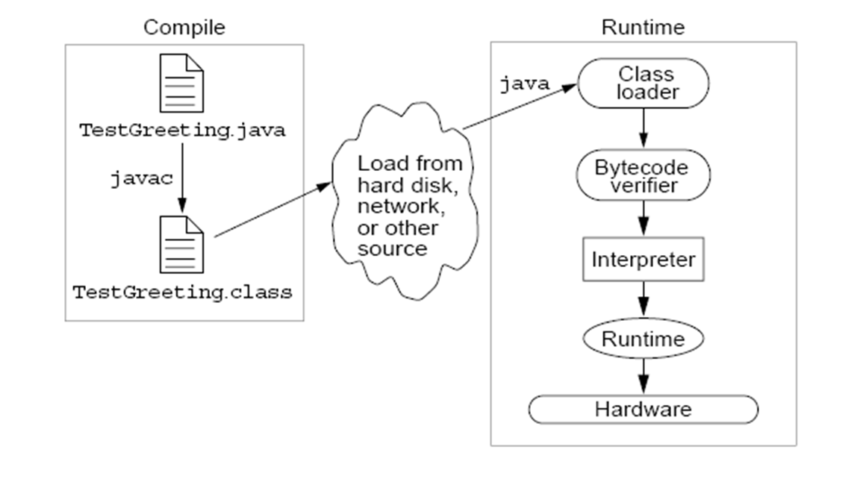
The Java Runtime Environment
The following figure displays the operation of the JRE.

Slide 10
JVM™ Tasks
The main tasks performed by the JVM are:
  Loading: It is performed by the class loader to load the code.
  Verifying: It is performed by the bytecode verifier to verify the code.
  Executing: It is performed by the runtime interpreter to execute the code.

Slide 11
The Class Loader
The class loader:
  Loads all classes necessary for the execution of a program.
  Adds security by separating the namespaces for the classes of the local file system from those imported from network sources.

Slide 12
The Bytecode Verifier
The JVM puts the code through a bytecode verifier that tests the format of code fragments and checks code fragments for illegal code.
The bytecode verifier ensures that:
  The code adheres to the JVM specifications and does not violate system integrity.
  The code causes no operand stack overflows or underflows.
  The types of parameters for all operational codes are correct.
  No illegal data conversions, such as converting integers to object references, have occurred.

Slide 13
Demo: A Simple Java Application
Let us see the demonstration of creating and executing a simple Java application.

Slide 14
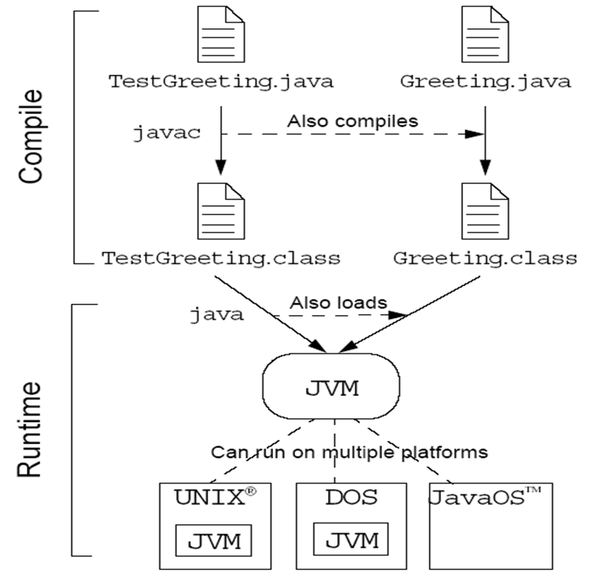
Demo: A Simple Java Application (Contd.)
  The following figure displays how Java programs can be compiled and then run on the JVM.

Slide 15
Declaring Java Technology Classes
The Java technology class declaration takes the following form:
  <modifier>* class <class_name>
  { <attribute_declaration>*
  <constructor_declaration>*
  <method_declaration>*
  }

Slide 16
Declaring Attributes
The declaration of an object attribute takes the following form:
  <modifier>* <type> <name> [ = <initial_value>];

Slide 17
Declaring Methods
The method declaration takes the following basic form:
  <modifier>* <return_type> <name> ( <argument>* ){ <statement>* }

Slide 18
Accessing Object Members
To access object members, including attributes and methods, dot notation(.) is used.
The dot notation is:
<object>.<member>

Slide 19
Information Hiding
Information hiding means ignoring the non-essential details of an object and concentrating on its essential details.
This concept is also called as abstraction.

Slide 20
Encapsulation
Encapsulation provides data representation flexibility by:
  Hiding the implementation details of a class.
  Forcing the user to use an interface to access data.
  Making the code more maintainable.

Slide 21
Declaring Constructors
A constructor is a set of instructions designed to initialize an instance.
The basic declaration of a constructor takes the following form:
  [<modifier>] <class_name> ( <argument>* )
  { <statement>* }

Slide 22
Declaring Constructors (Contd.)
Every class has at least one constructor.
If the programmer does not supply any constructor, the default constructor is present automatically.
The characteristics of default constructor are:
  It takes no arguments.
  It has empty body.
  It enables you to create object instances with new classname() without having to write a constructor.

Slide 23
Demo: Constructors
Let us see the demonstration of declaring constructors.

Slide 24
Source File Layout
A Java source file takes the following form:
  [<package_declaration>]
  <import_declaration>*
  <class_declaration>+

Slide 25
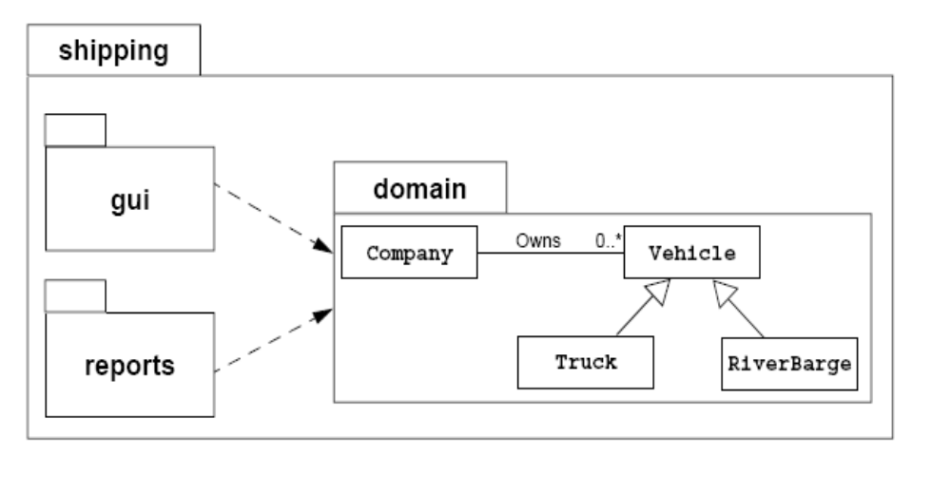
Software Packages
Packages help manage large software systems.
Packages can contain classes and sub-packages.
The following figure displays a sample package structure.

Slide 26
The package Statement
Java provides the package statement as a way to group related classes.
The package statement takes the following form:
package <top_pkg_name>[.<sub_pkg_name>]*;

Slide 27
The import Statement
An import statement is used to tell the compiler where to find the classes given in a particular package.
The import statement:
  Precedes all class declarations.
  Tells the compiler where to find classes.
The import statement takes the following form:
  import
    <pkg_name>[.<sub_pkg_name>]*.<class_name>;
    or
    import <pkg_name>[.<sub_pkg_name>]*.*;

Slide 28
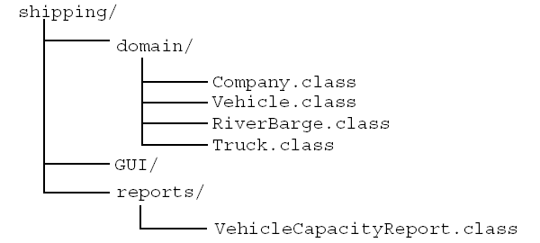
Directory Layout and Packages
Packages are stored in a directory tree starting with a package name.
The following figure displays a sample class package directory structure.

Slide 29
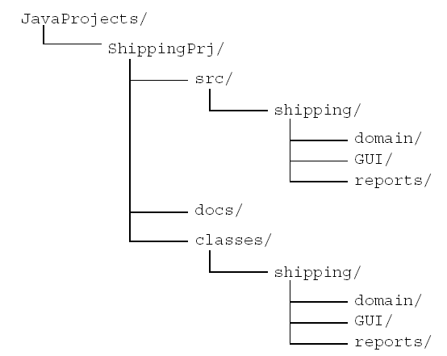
Development
The following figure displays a sample development directory hierarchy for a development project.

Slide 30
Compiling Using the -d Option
The Java compiler places the class files in the same directory as the source files.
The class files can be rerouted to another directory using the -d option of the javac command.
The simplest way to compile files within packages is to be working in the directory one level above the beginning of the package.
The following commands are used to compile all the files within the shipping.domain package and have the compiled classes in their correct package directory under ShippingPrj/class/:
  cd JavaProjects/ShippingPrj/src
  javac -d ../classes shipping/domain/*.java

Slide 31
Deployment
An application can be deployed on a client machine without manipulating the user’s CLASSPATH environment variable.
Deployment is done by creating an executable Java archive (JAR) file. To create an executable JAR file, perform the following steps:
  Create a temporary file that indicates the class name that contains the main method:
Main-Class: mypackage.MyClass
  Build the JAR file by adding an additional option (m) so that the contents of this temporary file are copied into the META-INF/MANIFEST.MF file:
jar cmf tempfile MyProgram.jar

Slide 32
Deployment (Contd.)
  Run the program by executing the following command:
java -jar /path/to/file/MyProgram.jar
To deploy a library code in a JAR file, copy the JAR file into the ext subdirectory of the lib directory in the main directory of the JRE.

Slide 33
Summary
In this session, you learned that:
  The Java technology is:
    A programming language.
    A development environment.
    An application environment.
    A deployment environment.
  JVM can be defined as an imaginary machine that is implemented by emulating it in software on a real machine.
  Java source files are compiled, get converted into a bytecode file. At runtime, the bytecodes are loaded, checked, and run in an interpreter.
  Garbage collector checks for and frees memory no longer needed, automatically.

Slide 34
Summary (Contd.)
  The three main tasks performed by the JVM include:
    Loading
    Verifying
    Executing
  Abstraction means ignoring the non-essential details of an object and concentrating on its essential details.
  Encapsulation provides data representation flexibility by hiding the implementation details of a class.
  The dot operator enables you to access non-private attribute and method members of a class.
  A constructor is a set of instructions designed to initialize an instance of a class.
  Java provides the package statement as a way to group related classes.

Slide 35
Summary (Contd.)
  The import statement tells the compiler where to find the classes which are grouped in packages.
  The class files can be rerouted to another directory using the -d option of the javac command.
  An executable JAR file is used to deploy an application on a client machine without manipulating the user’s CLASSPATH environment variable.

